Slide 1



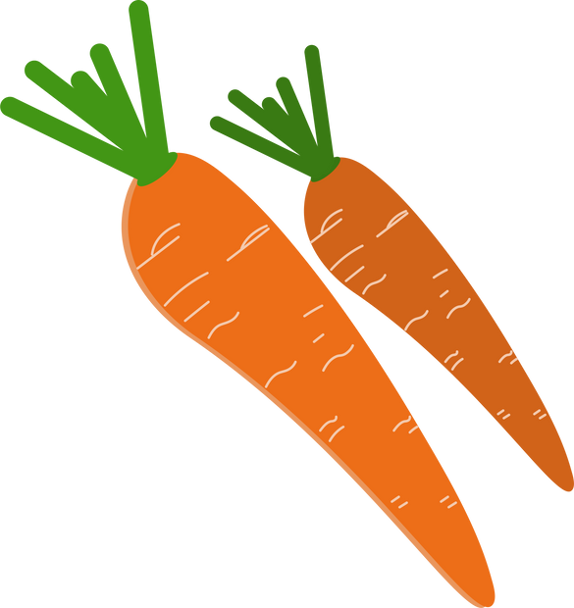
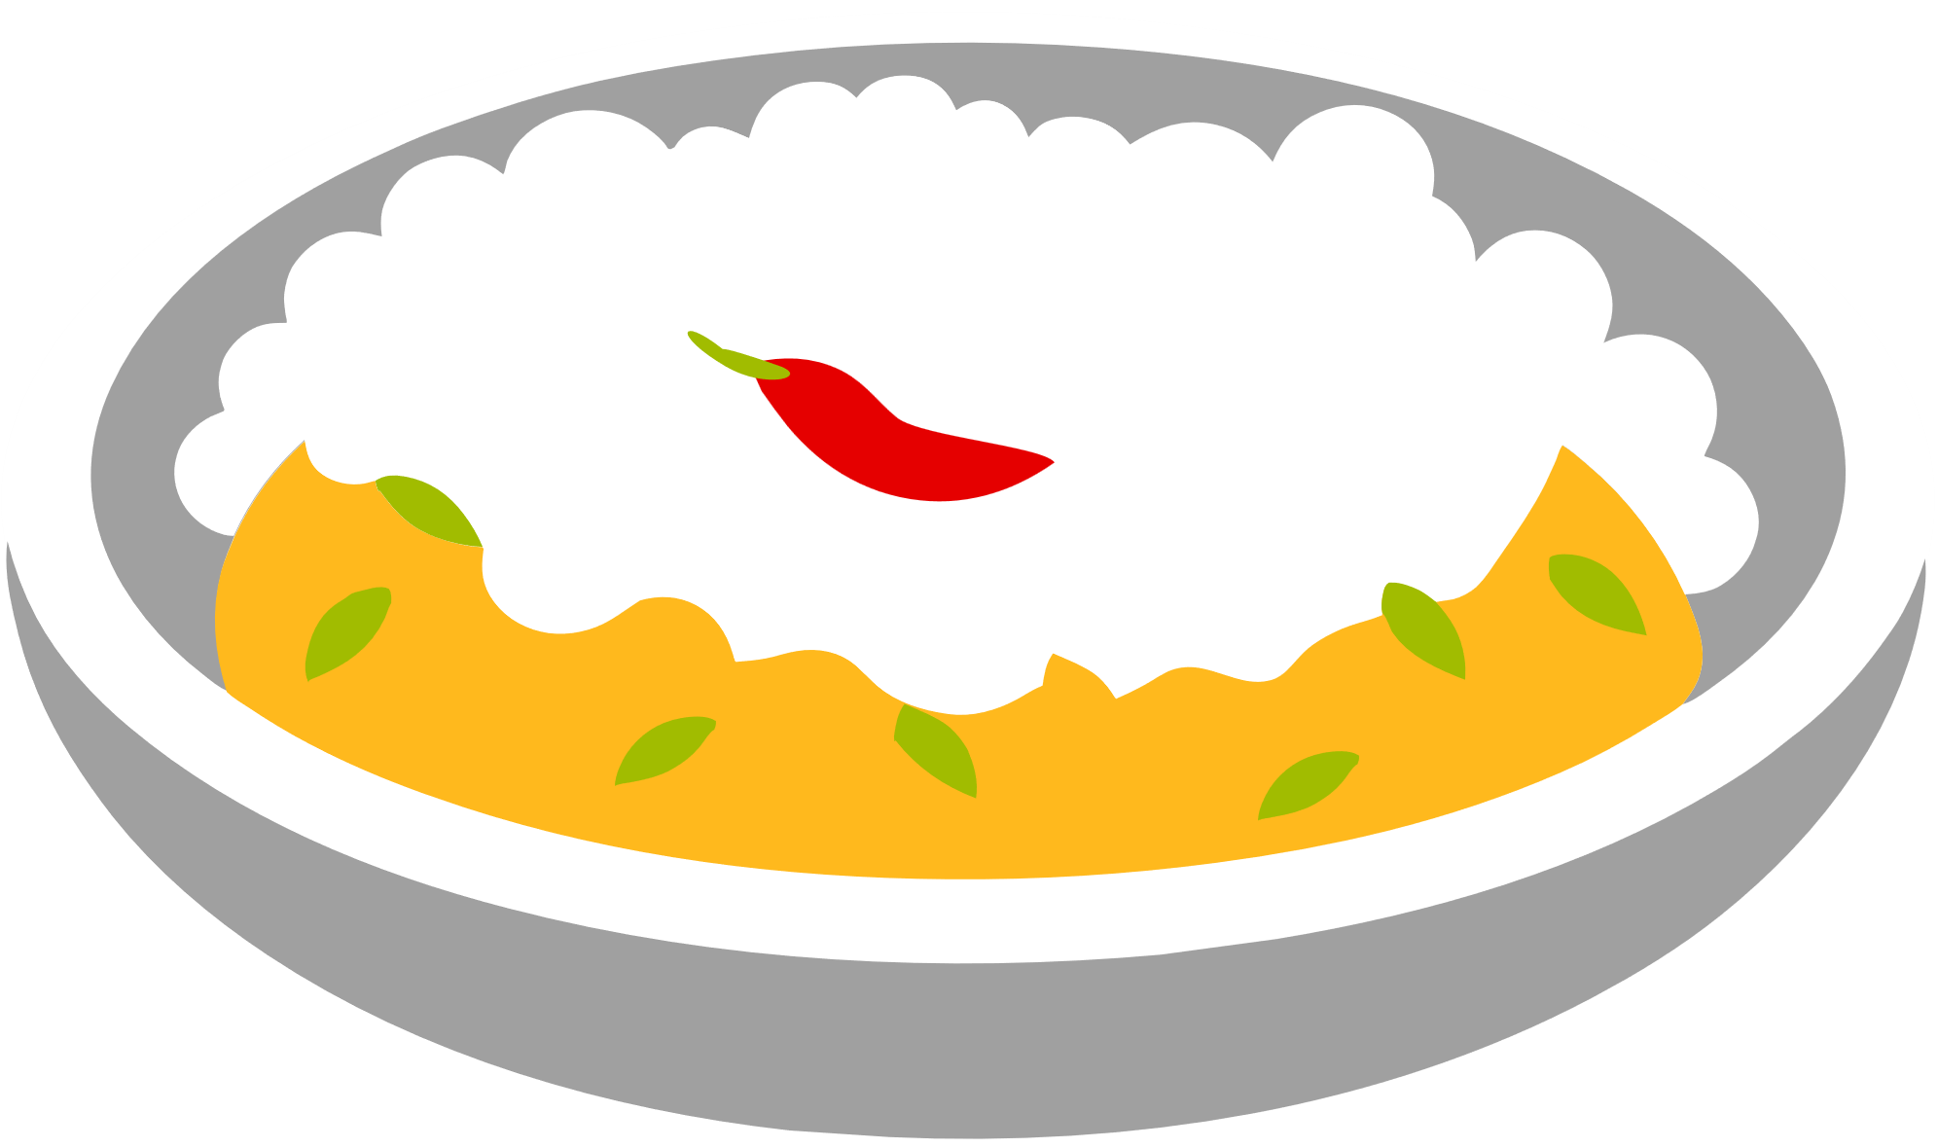
Nutrition Tracker
&
Food Recommendation
System
Final Defense Project Presentation

Slide 2
CONTENT
01
INTRODUCTION
02
OBJECTIVES
03
METHODOLOGY
04
PROJECT IMPLEMENTATION
05
ER DIAGRAM,USE CASE DIAGRAM
06
DESIGN & DEVELOPMENT
07
PROJECT TIMELINE
08
LIMITATIONS & FUTURE AIM
09
PROJECT OUTCOME

Slide 3
The Team
Team Members
Supervisor
Bhupesh Shrestha (20070055)
Ganesh Raj Gautam (20070062)
Kosul Gurung (20070068)
Ritik Gurung (20070079)
Sobit Thapa (20070086)
Mr. Anup Acharya
Associate Professor
School of Engineering
Pokhara University

Slide 4
Introduction
What is NutriTracker?
A dynamic Food Tracking Application that can:
keep records of the foods logged by user
recommend appropriate foods to user
search large variety of foods
provide nutritional values of foods

Slide 5
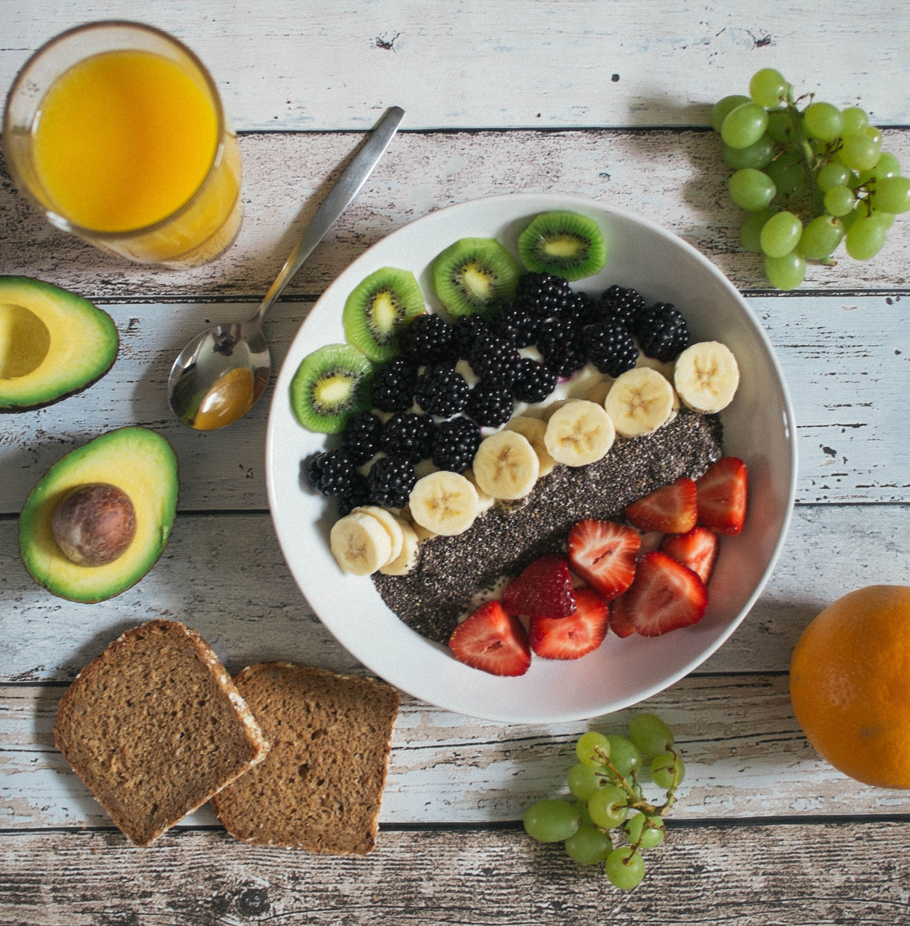
OBJECTIVES
Our Objective is simple.
To:
Provide users a platform to log daily food records
Recommend healthy foods for users

Slide 6
METHODOLOGY
SIGN IN
CALCULATE BMR
DISEASES/DIET
RECOMMEND FOOD

Slide 7
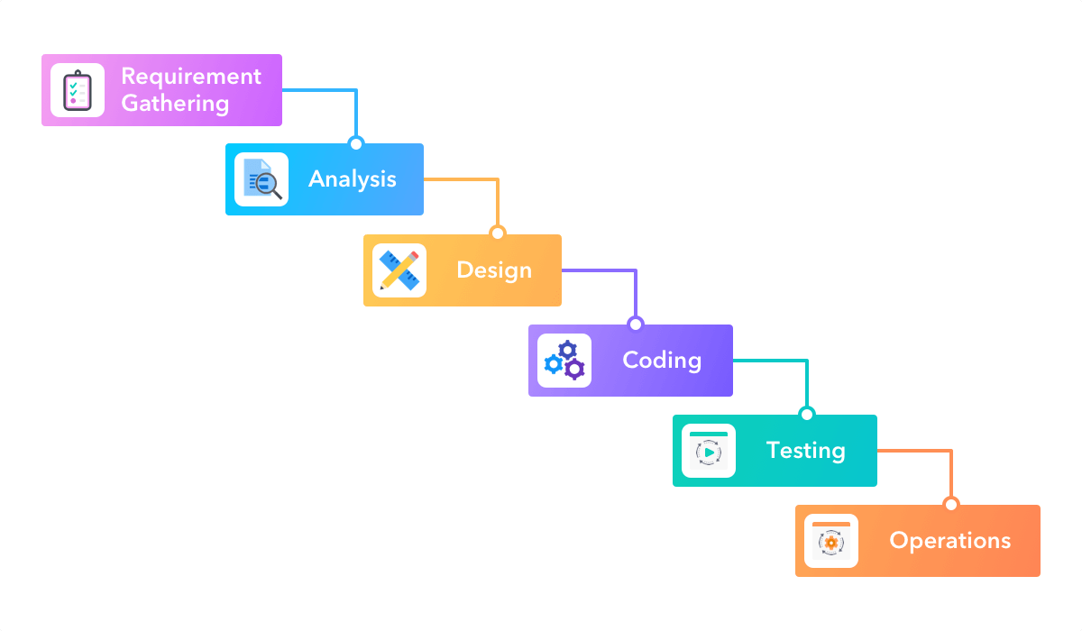
WATERFALL MODEL

Slide 8
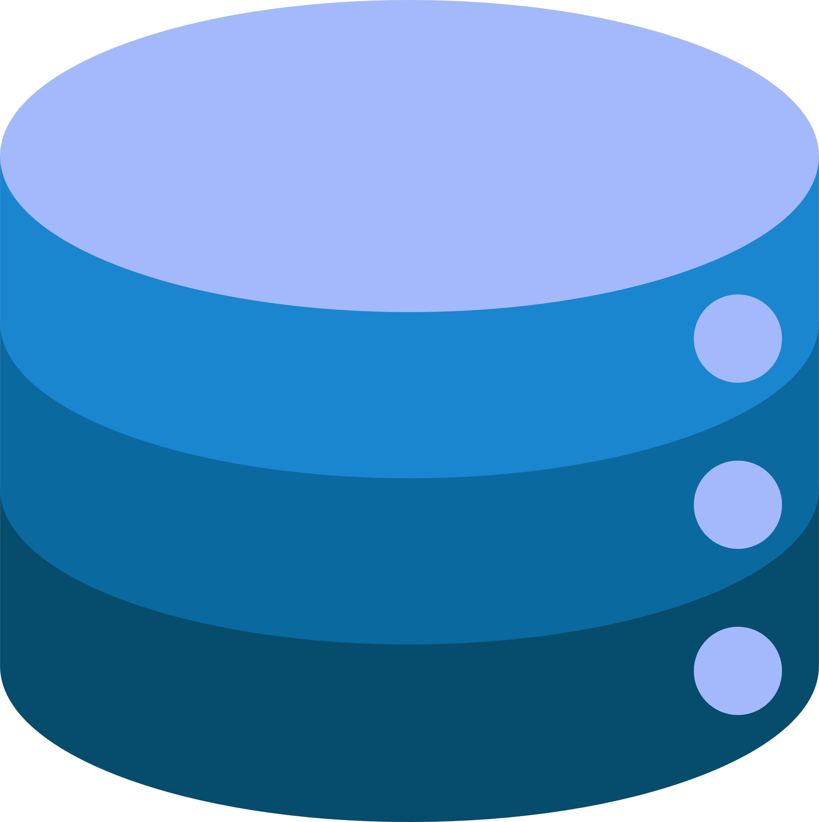
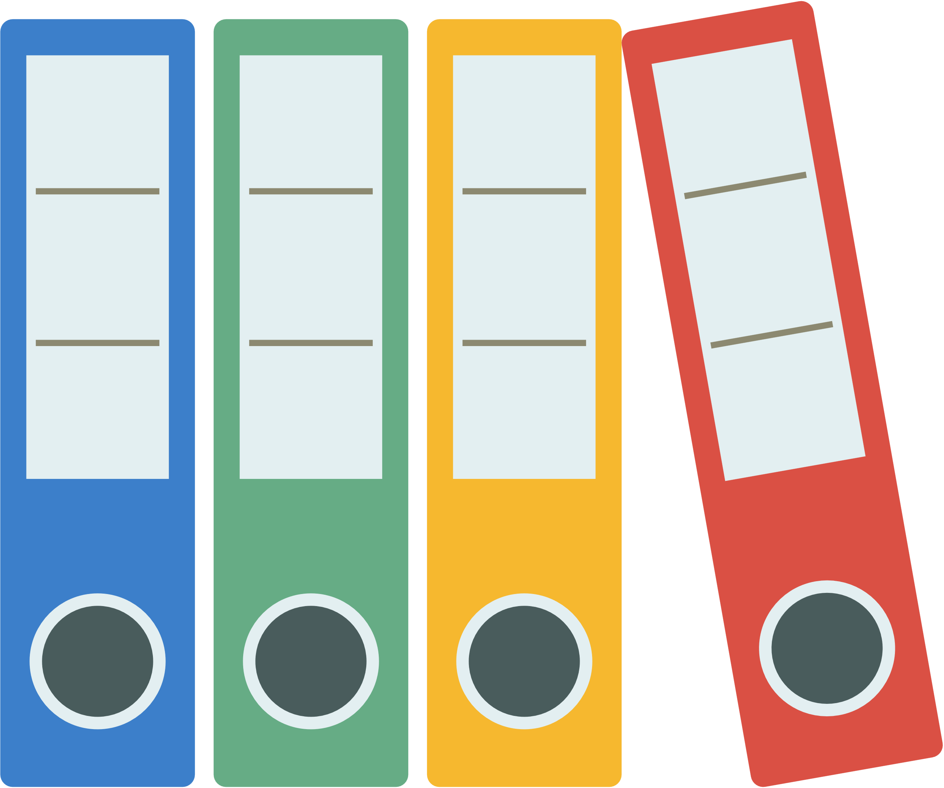
PROJECT IMPLEMENTATION
A
P
I
A
P
P
MONGO
DB
SERVER
APP
REACT
EXPRESS
BROWSER
NODE JS
CLIENT MACHINE
BACKEND
MONGO DB

Slide 9
GANTT CHART
TASKS
Requirement
Design
Coding
Testing
Documentation
MAY | JUNE | JULY | AUGUST

Slide 10
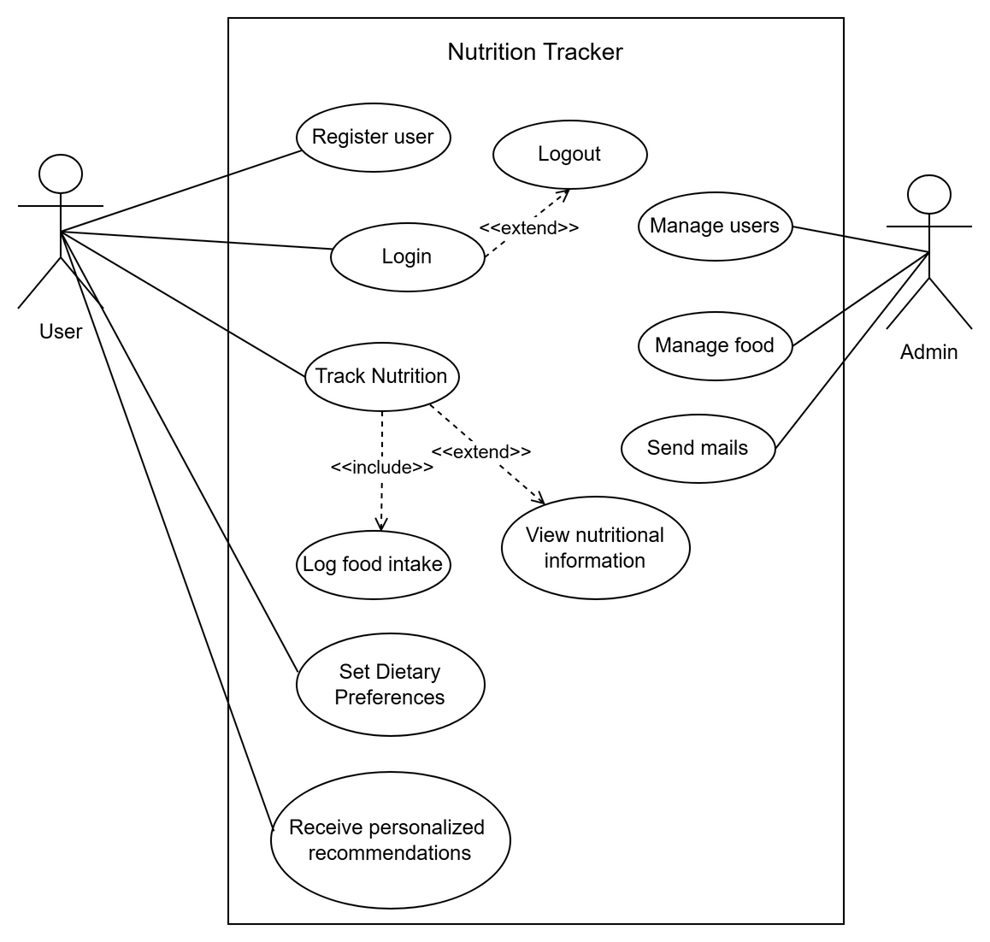
Use Case Diagram

Slide 11
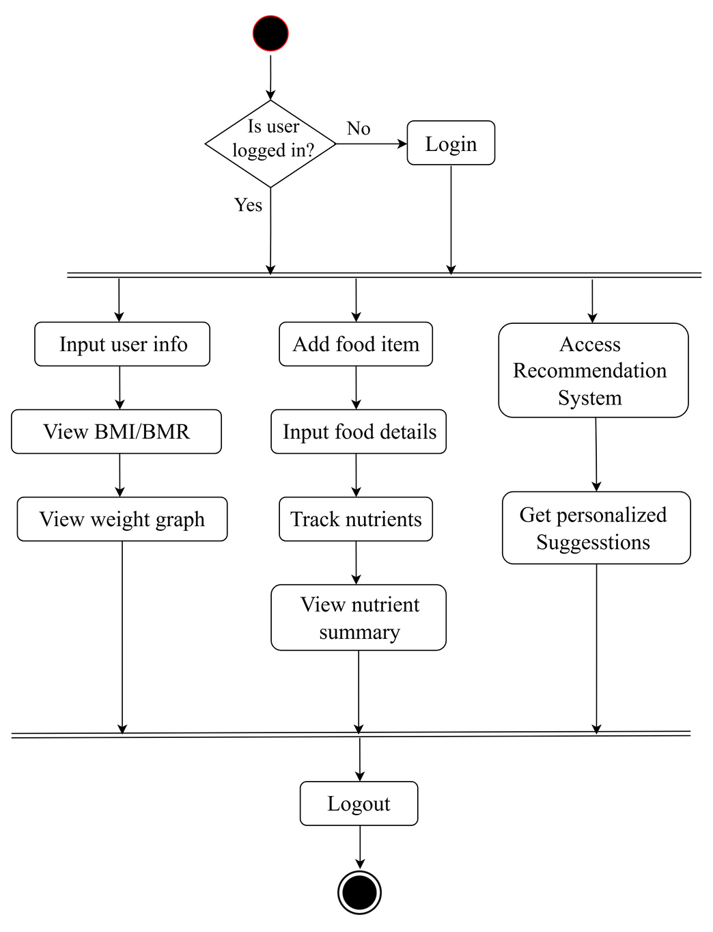
Activity Diagram for verified user

Slide 12
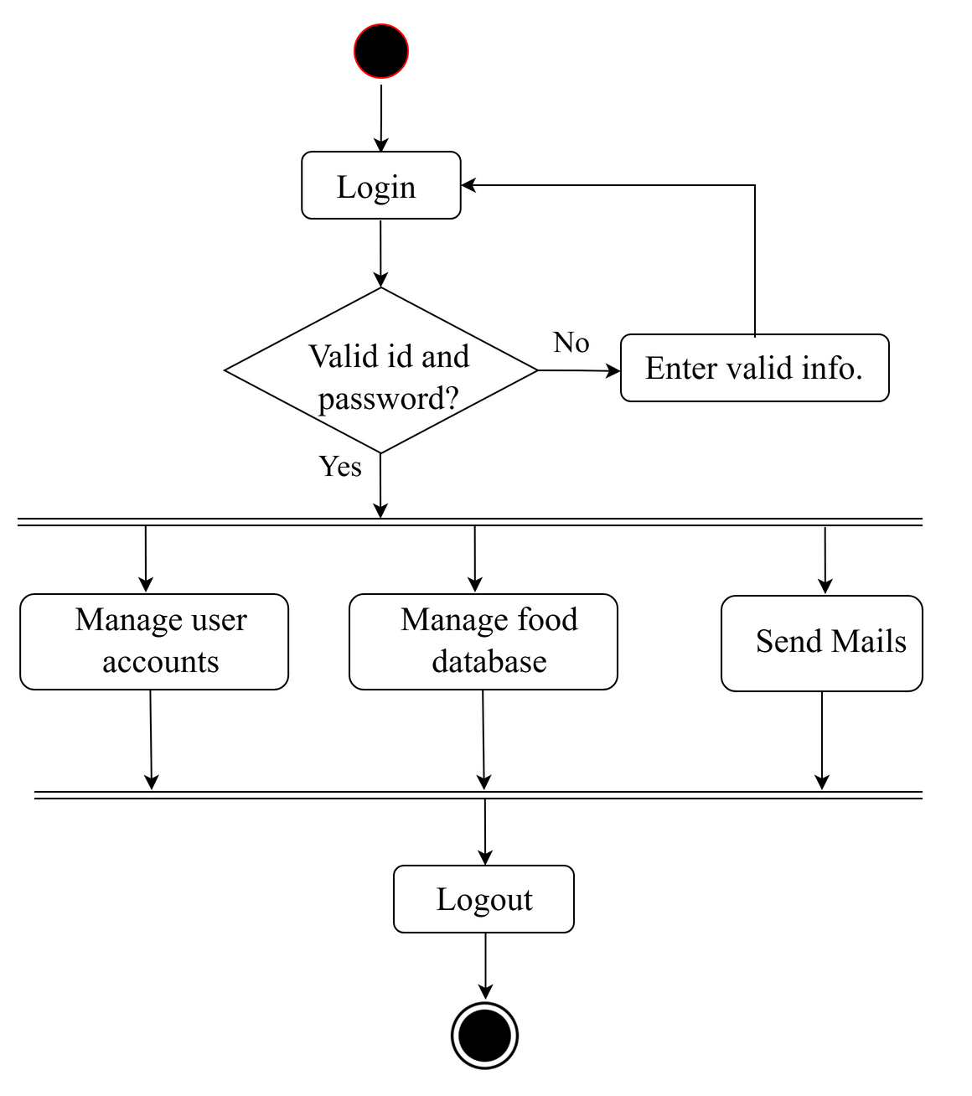
Activity Diagram for admin

Slide 13
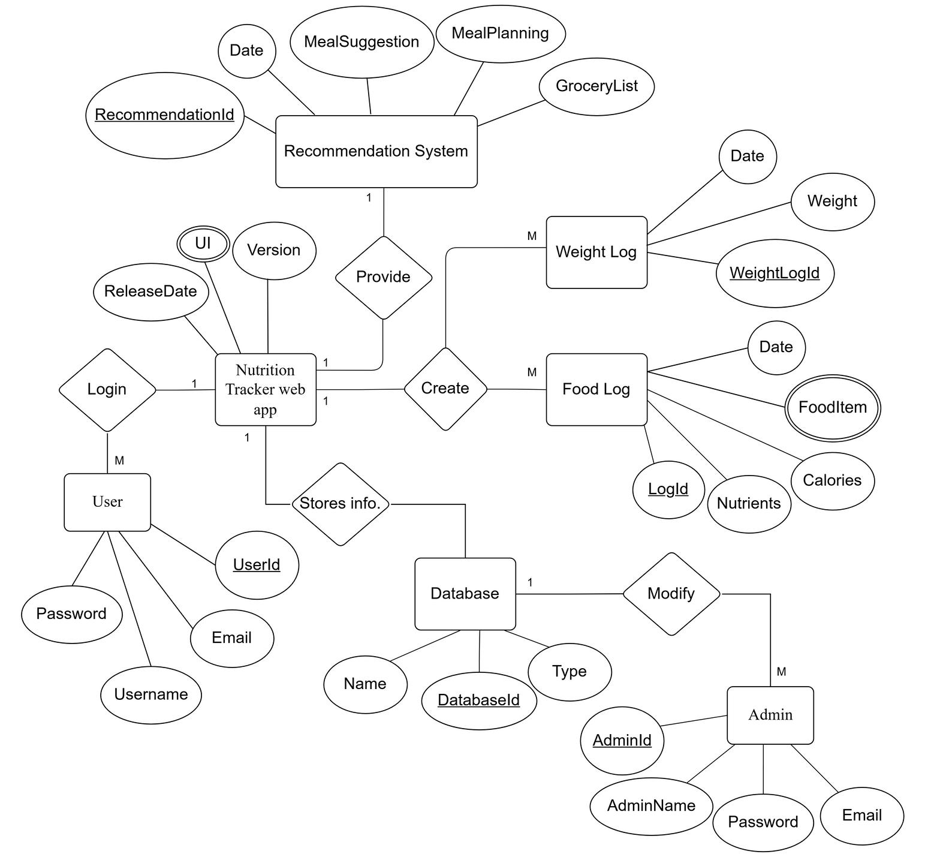
ER-Diagram

Slide 14

LIMITATIONS
The following limitations were encountered:
The recipes for food are not available.
Food Images of all food items are not available.
Food recommendation data is not much vast.

Slide 15
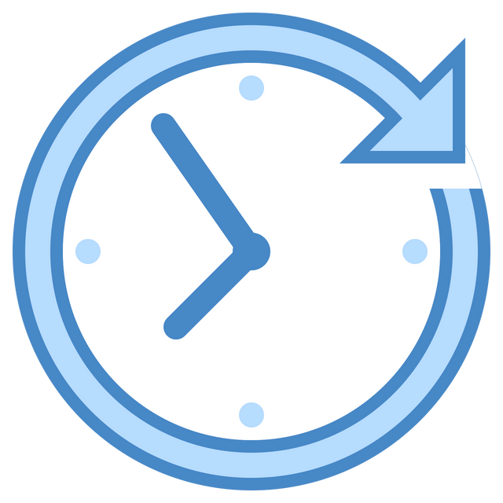
FUTURE RECOMMENDATIONS
Collaborative Filtering
ChatBots and FAQ
Food Image Scanners
Smart AI generated diet plans.

Slide 16
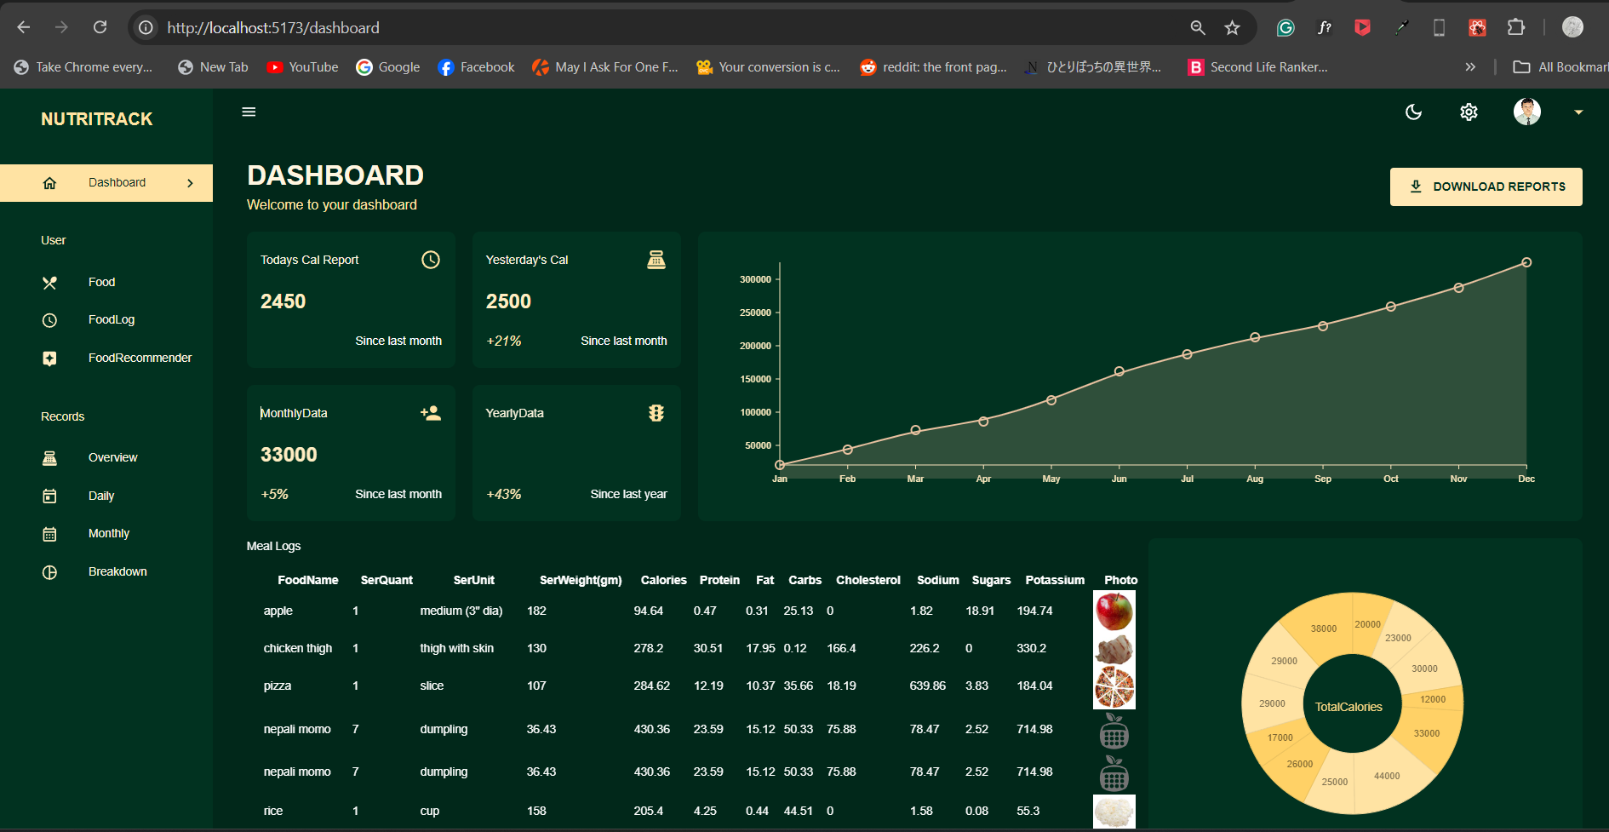
PROJECT OUTCOMES

Slide 17
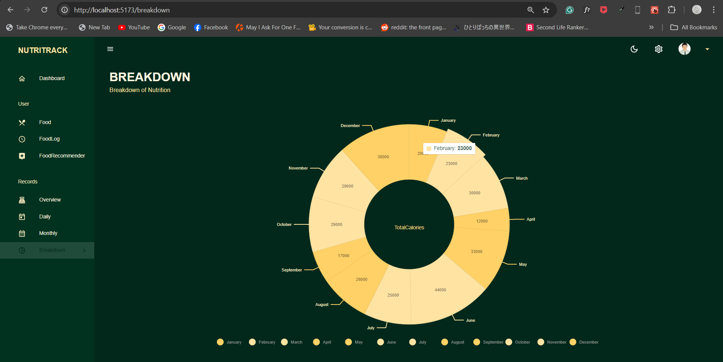
PROJECT OUTCOMES

Slide 18

LIVE DEMONSTRATION

Slide 19

Any Queries?

Slide 20


